Slide 1


INNOVATION MANAGEMENT AND SOCIAL NETWORKS: AN INSEPARABLE RELATIONSHIP
Prof. Dr. Jan Kratzer
Prof. Dr. Kratzer, Lehrstuhl für Entrepreneurship und Innovationsmanagement

Slide 2
Increase of using the term „social networks“ in journal-abstracts
Prof. Dr. Kratzer, Lehrstuhl für Entrepreneurship und Innovationsmanagement

Slide 3
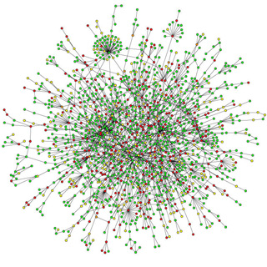
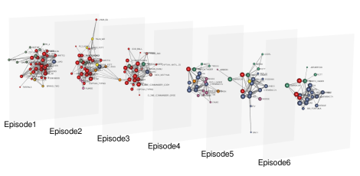
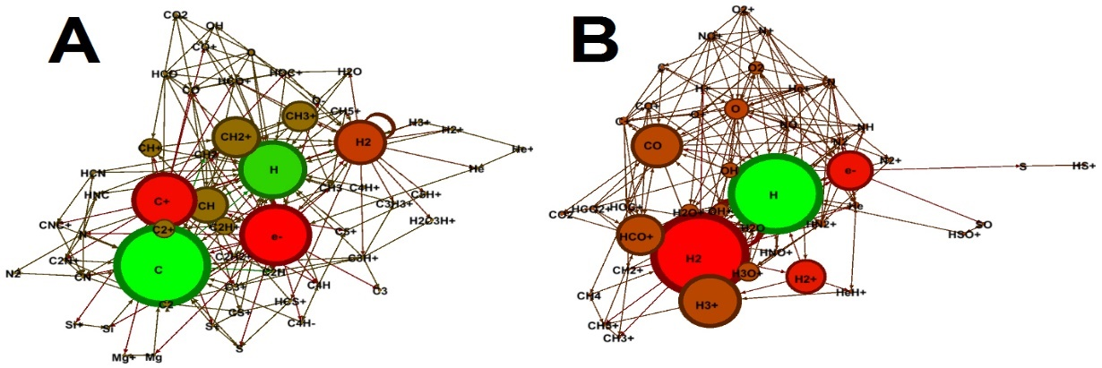
„Social networks“ in different disciplines
Biology (Image by Hawoong Jeong, KAIST, Korea)
Literature/Arts (Star Wars Saga)
Chemistry (Jolley, C.C. & Douglas, T. (2010). Ion Accumulation in a Protein Nanocage: Finding Noisy Temporal Sequences Using a Genetic Algorithm. Biophysical Journal, 99(10): 3385-3393)
Prof. Dr. Kratzer, Lehrstuhl für Entrepreneurship und Innovationsmanagement

Slide 4
Google Scholar „Social Networks and Innovation Management“
2.200.000 references (0.09s)
Journal of Product Innovation Management - JPIM:
„Social Networks and Innovation Management“ – 546 references
Research Policy:
„Social Networks and Innovation Management“ – 1367 references
R&D Management:
„Social Networks and Innovation Management“ – 568 references
Creativity and Innovation Management:
„Social Networks and Innovation Management“ – 381 references
Prof. Dr. Kratzer, Lehrstuhl für Entrepreneurship und Innovationsmanagement

Slide 5
„Social networks“ – Short History
Mathematics – goes back to Euler (1736) who translated the Konigsberg Bridge problem into a mathematical notion of points and lines
The sociogram was introduced by Moreno (1934)
Anthropology – milestone ‘Hawthorne Experiment’ (1927-1932) (Warner, Mayo, Roethlisberger, Dickson)
Psychology – gestalt tradition, names as Kohler, Lewin, Moreno, Heider (founded method and journal of sociometry)
Davis (1953) ‘Grapevine-study’
Menzel/Katz/Coleman (1957/69) `Diffusion of Innovation`
Homans (1951/73) ‘Cohesion-compliance hypothesis’
Granovetter (1974) ‘Getting a job’ (1974)
Allen (1977/84) `Communication and Performance`
Burt (1992) `Structural Holes`
Prof. Dr. Kratzer, Lehrstuhl für Entrepreneurship und Innovationsmanagement

Slide 6
Innovation Management – Hot Issues
Users and Innovation
Technology Transfer
Alliances and Cooperations
Projects/Teams/Leadership
i,e,: Mapping the Topic Landscape of JPIM, 1984–2013: In Search of Hidden Structures and Development Trajectories* David Antons, Robin Kleer, and Torsten Oliver Salge (2015)
Prof. Dr. Kratzer, Lehrstuhl für Entrepreneurship und Innovationsmanagement

Slide 7
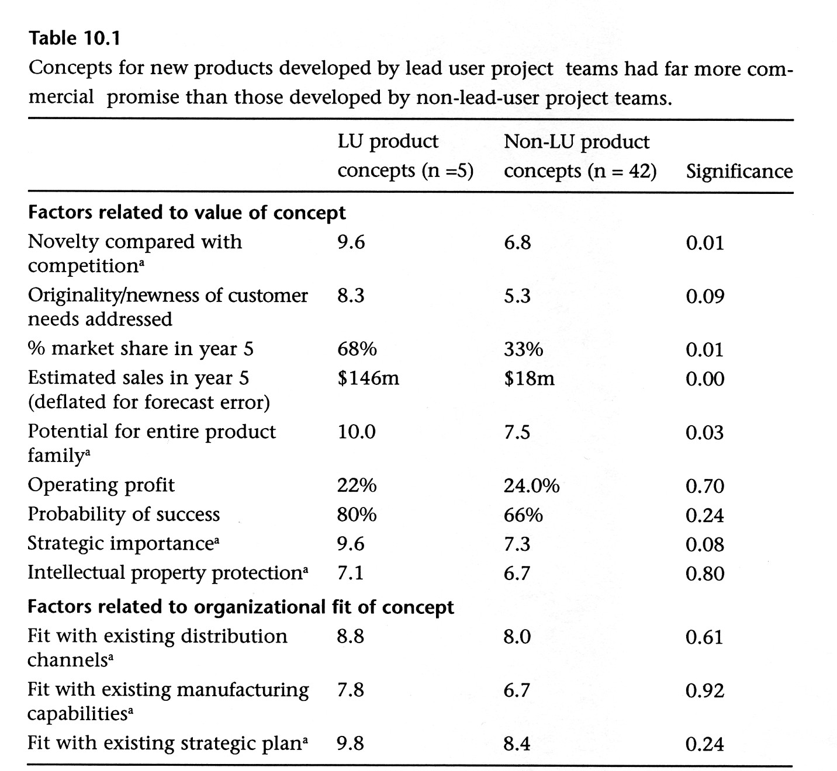
Users and Innovation
(Von Hippel, 2005)
Prof. Dr. Kratzer, Lehrstuhl für Entrepreneurship und Innovationsmanagement

Slide 8
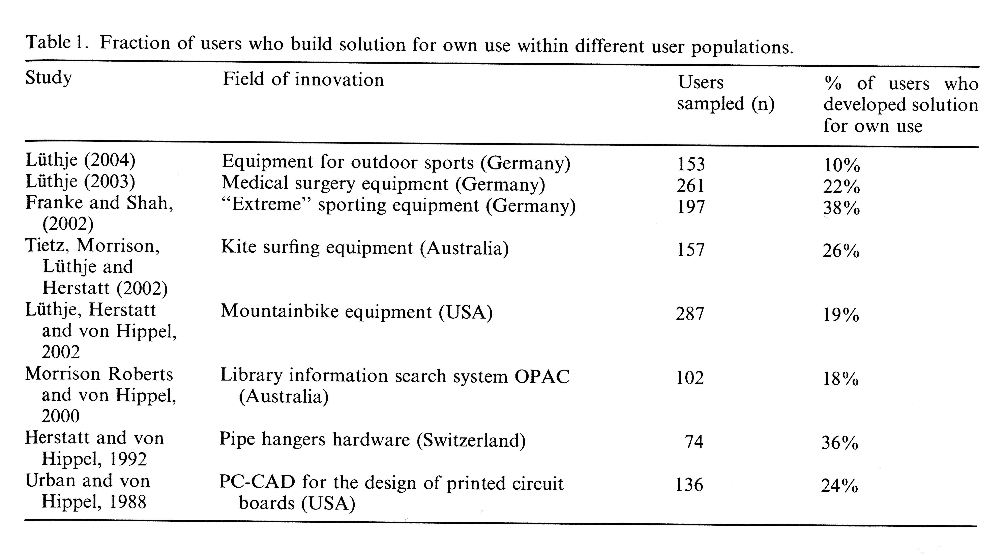
(Franke, Von Hippel, Schreier 2006)
Prof. Dr. Kratzer, Lehrstuhl für Entrepreneurship und Innovationsmanagement

Slide 9
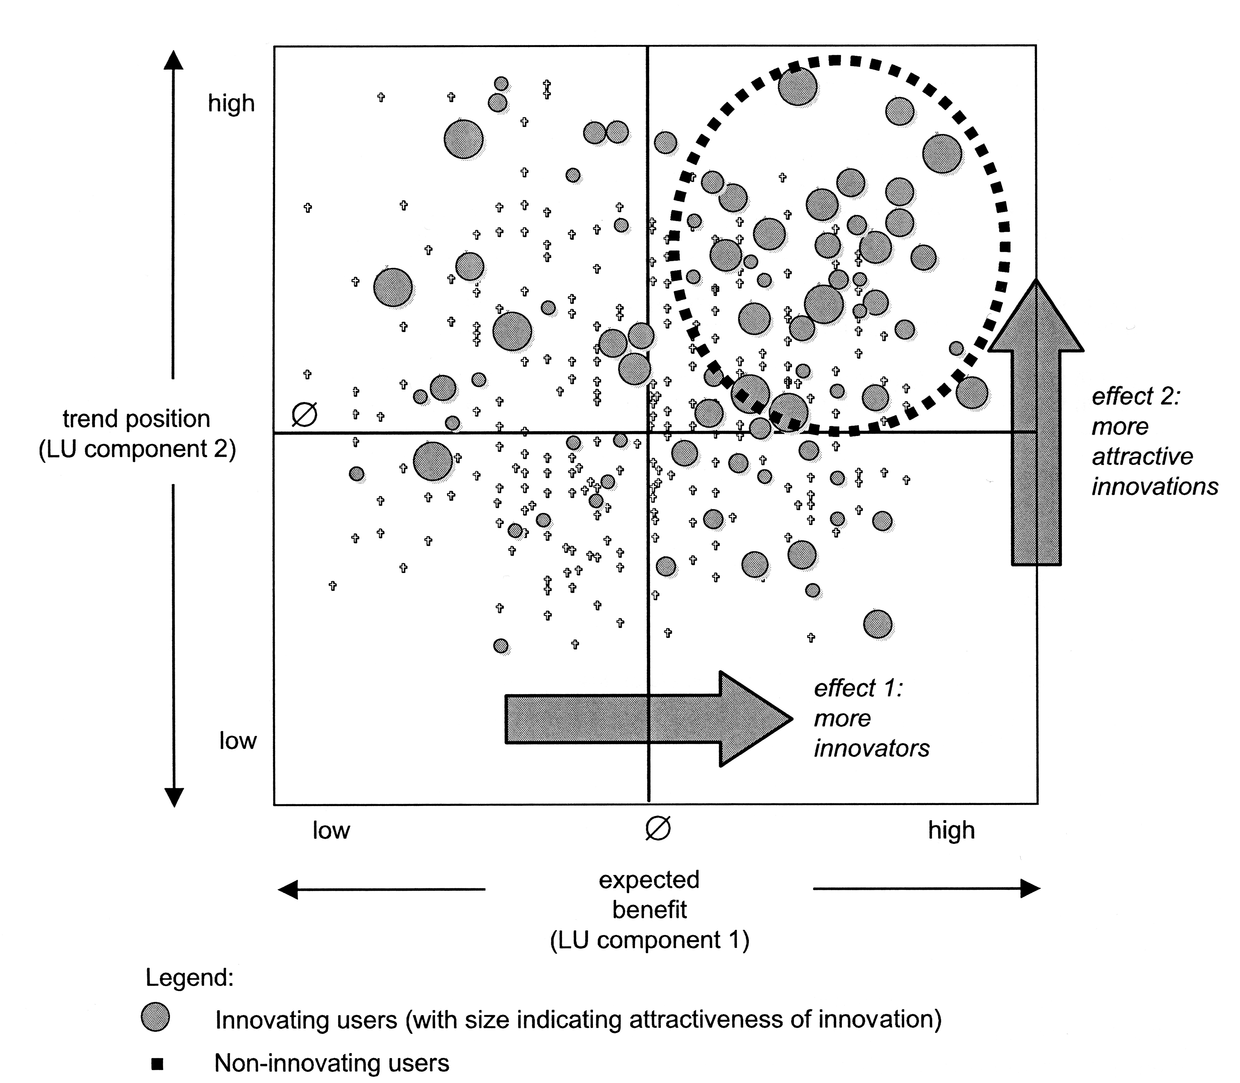
(Franke, Von Hippel, Schreier 2006)
Prof. Dr. Kratzer, Lehrstuhl für Entrepreneurship und Innovationsmanagement

Slide 10









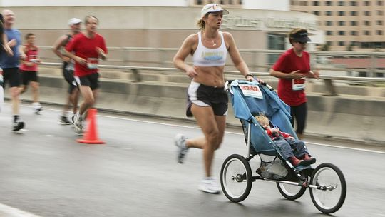

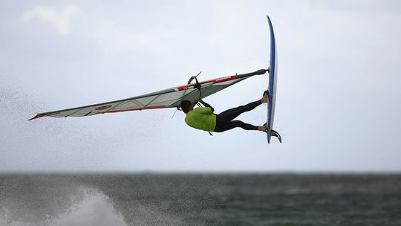



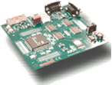

Prof. Dr. Kratzer, Lehrstuhl für Entrepreneurship und Innovationsmanagement

Slide 11
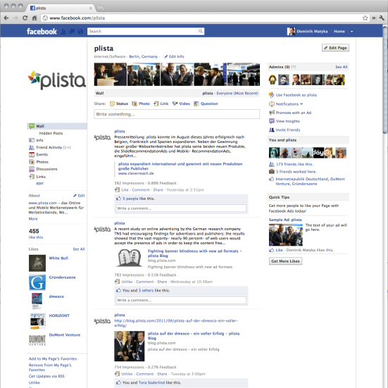
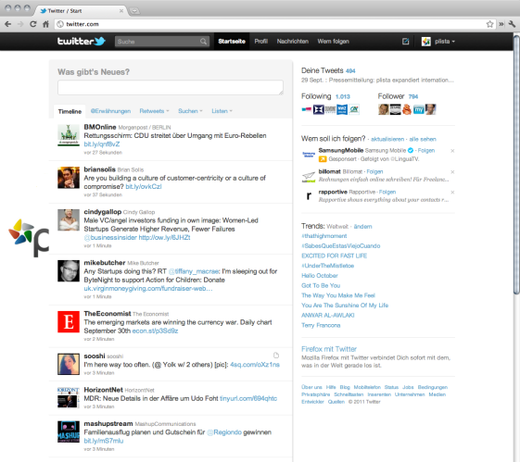
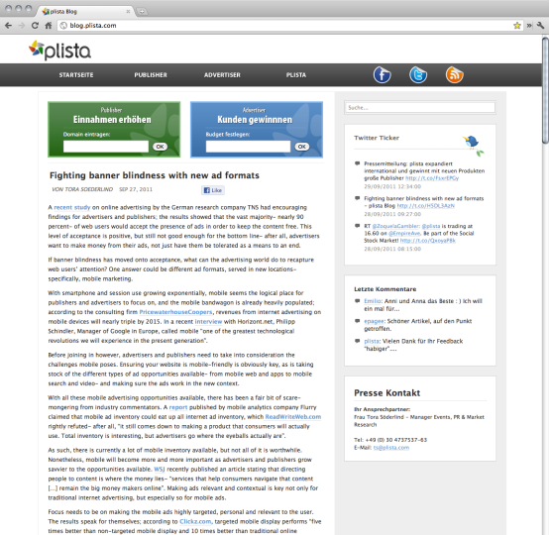
Facebook
Twitter
Weblogs
User: < 800 Millionen < 300 Millionen < 300 Millionen
Prof. Dr. Kratzer, Lehrstuhl für Entrepreneurship und Innovationsmanagement

Slide 12
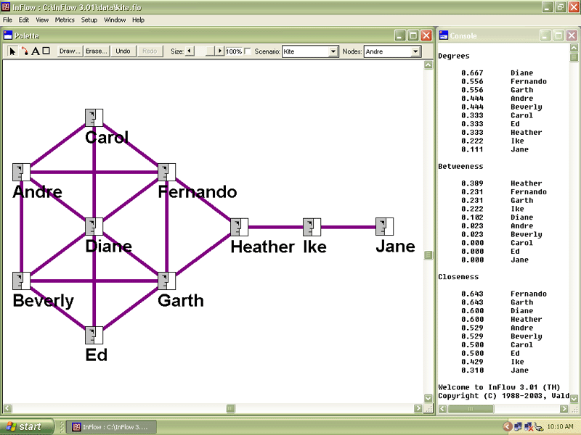
Prof. Dr. Kratzer, Lehrstuhl für Entrepreneurship und Innovationsmanagement

Slide 13
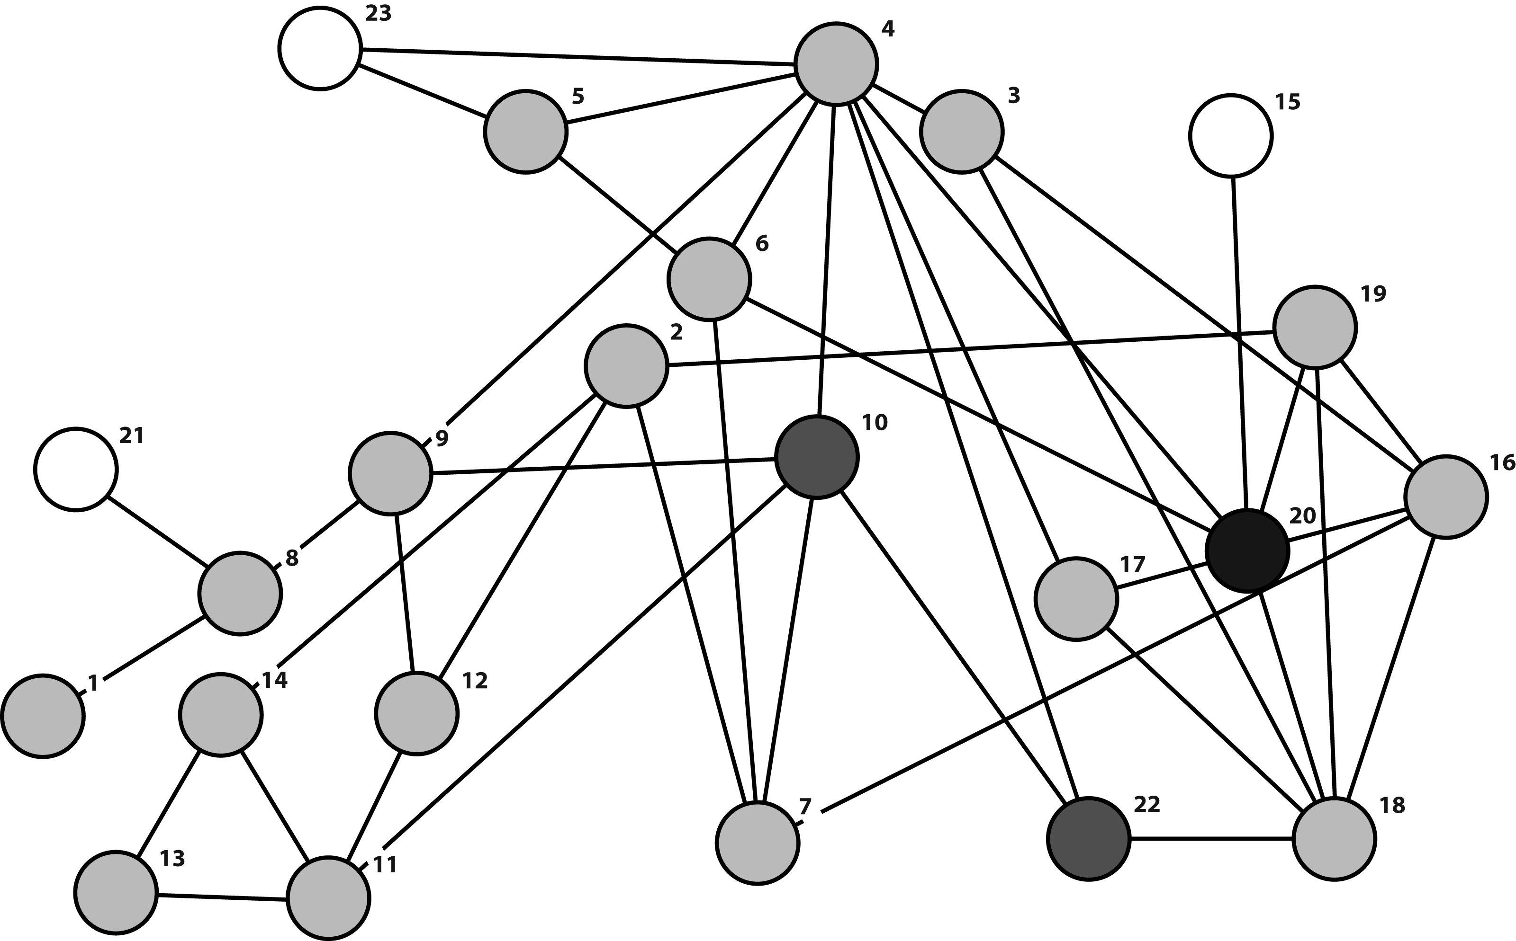
Scientific study I
The first study encompasses 31 school classes with 804 pupils aged between 7 to 17.
Prof. Dr. Kratzer, Lehrstuhl für Entrepreneurship und Innovationsmanagement

Slide 14
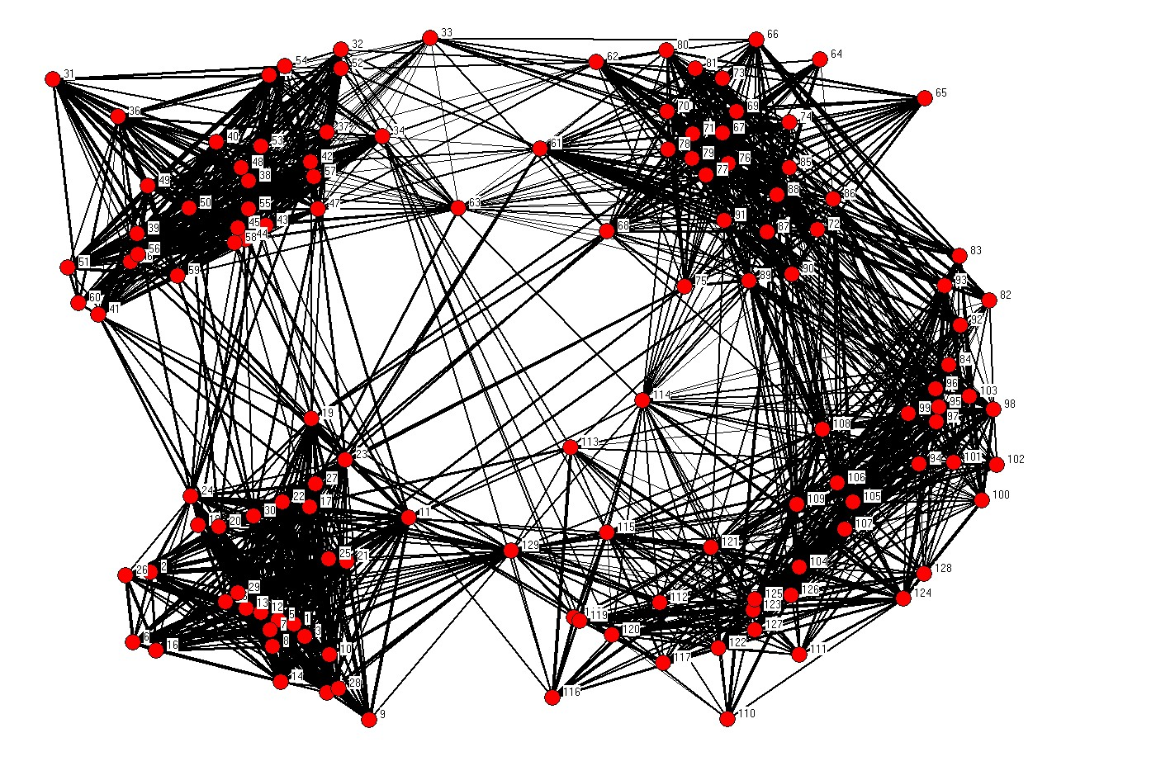
Prof. Dr. Kratzer, Lehrstuhl für Entrepreneurship und Innovationsmanagement

Slide 15

Scientific study II
The question – can you measure social networks among children and young adults using qiestionnaire?
In order to answer this question we conducted an experiment in 16 school classes. The children and young adults got a task and could freely interact. We recorded all with a camera.
The task was to improve an existing online platform.
The results of the task were evaluated by two experts according to newness and useability. We used this as measure for creativity.
Prof. Dr. Kratzer, Lehrstuhl für Entrepreneurship und Innovationsmanagement

Slide 16
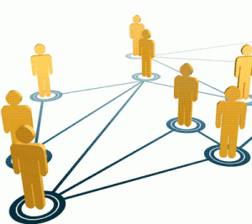
Results I and II
1. The findings in the questionnaire statistical significant correlate with the camera recording ( QAP-correlation < .7)
=
2. Children and young adults with lead user characteristics are statistically significant more creative.
3. . Children and young adults with a high betweeness centrality show more lead user characteristics (R²=41%)
4. Children and young adults with a high degree centrality show more opinion leader characteristics (R²=39%)
Prof. Dr. Kratzer, Lehrstuhl für Entrepreneurship und Innovationsmanagement

Slide 17
Scientific Study III
A third study was investigating a number of lead user projects by larger companies. In the context of this projects 140 lead users could be identified based on interviews, content analyses and problem broadcasting.
We have scanned these projects by using the software ‚Condor‘ developed by MIT, Peter Gloor. The underlying question was whether we could find the same persons using the software and calculating betweenness centrality.
http://swarmcreativity.blogspot.com/
Prof. Dr. Kratzer, Lehrstuhl für Entrepreneurship und Innovationsmanagement

Slide 18
Resultate III
Company | Industry | Number of interviews for lead user identification | Number of forums searched | Lead users identified
Deutsche Telekom | Telecommunications | 205 | 498 | 18
Deutsche Telekom | Telecommunications | 240 | n.a. | 9
Frequentis | Airline communications and information | 367 | n.a. | 10
I.S.A. | Automation | 270 | 28 | 7
Kotányi | Food | 220 | 162 | 9
MAM Babyartikel | Consumer goods | 246 | 137 | 9
OMV | Energy | 60 | n.a. | 7
Ottakringer | Food | 250 | 40 | 10
Palfinger | Forklift trucks | 160 | 200 | 9
Palfinger | Forklift trucks | 157 | 184 | 9
Schindler | Escalators | 223 | 10 | 10
Schindler | Escalators | 206 | 99 | 8
Siemens | Automotive | 158 | n.a. | 9
Siemens | Communications technology | 170 | n.a. | 8
Stock | Food | 186 | n.a. | 8
Result: Our study could identify more than 75% of the lead users.
Prof. Dr. Kratzer, Lehrstuhl für Entrepreneurship und Innovationsmanagement

Slide 19
Scientific Study IV
Another study, study IV, was engaged in one online forum – PlumbingForum.com in cooperation with Airbus.
This Forum has around 50000 members and contains about 575000 posts and 165000 threads.
Using ‚Condor‘ we indentified the betweenness centrality of the members and by analysing posts and threads of members using a Nethnography Method we determined the degree of lead user characeristics of the members.
Belz, F.-M., Baumbach, W. 2010. Netnography as a Method of Lead User Identification. Creativity and Innovation Management 19 (3) 304-313.
http://www.plbg.com/
Result: Members with lead user characteristics show a significant higher betweenness centrality.
Prof. Dr. Kratzer, Lehrstuhl für Entrepreneurship und Innovationsmanagement

Slide 20
J. Kratzer, Ch. Lettl, (2008) ‘A social network perspective of Lead Users and Creativity: An empirical study among children’, Creativity and Innovation Management, 17, pp. 26-36. Tudor Rickards BEST PAPER AWARD 2008
J. Kratzer, Ch. Lettl, (2009) ‘The distinctive role of lead users and opinion leaders in the social networks of schoolchildren', Journal of Consumer Research, 36, 646-659.
N. Osterloo, J. Kratzer, M. C. Achterkamp, (2010) 'Applying lead user theory to young adults', Young Consumers: Insight and Ideas for Responsible Marketers, 11, pp. 5-23. Outstanding Paper Award at LITERATI NETWORK AWARDS FOR EXCELLENCE 2011
J. Kratzer, Ch. Lettl (2011) 'Die Identifizierung von Lead Usern über soziale Netzwerke: Eine empirische Untersuchung unter jungen Konsumenten', Zeitschrift für Betriebswirtschaft, 5, pp. 83-110.
J. Kratzer, Ch. Lettl, N. Franke, P. Gloor (2015) ' Identifying Lead Users in Social Networks', Journal of Product Innovation Management, 33, pp. 201-216.
Prof. Dr. Kratzer, Lehrstuhl für Entrepreneurship und Innovationsmanagement

Slide 21
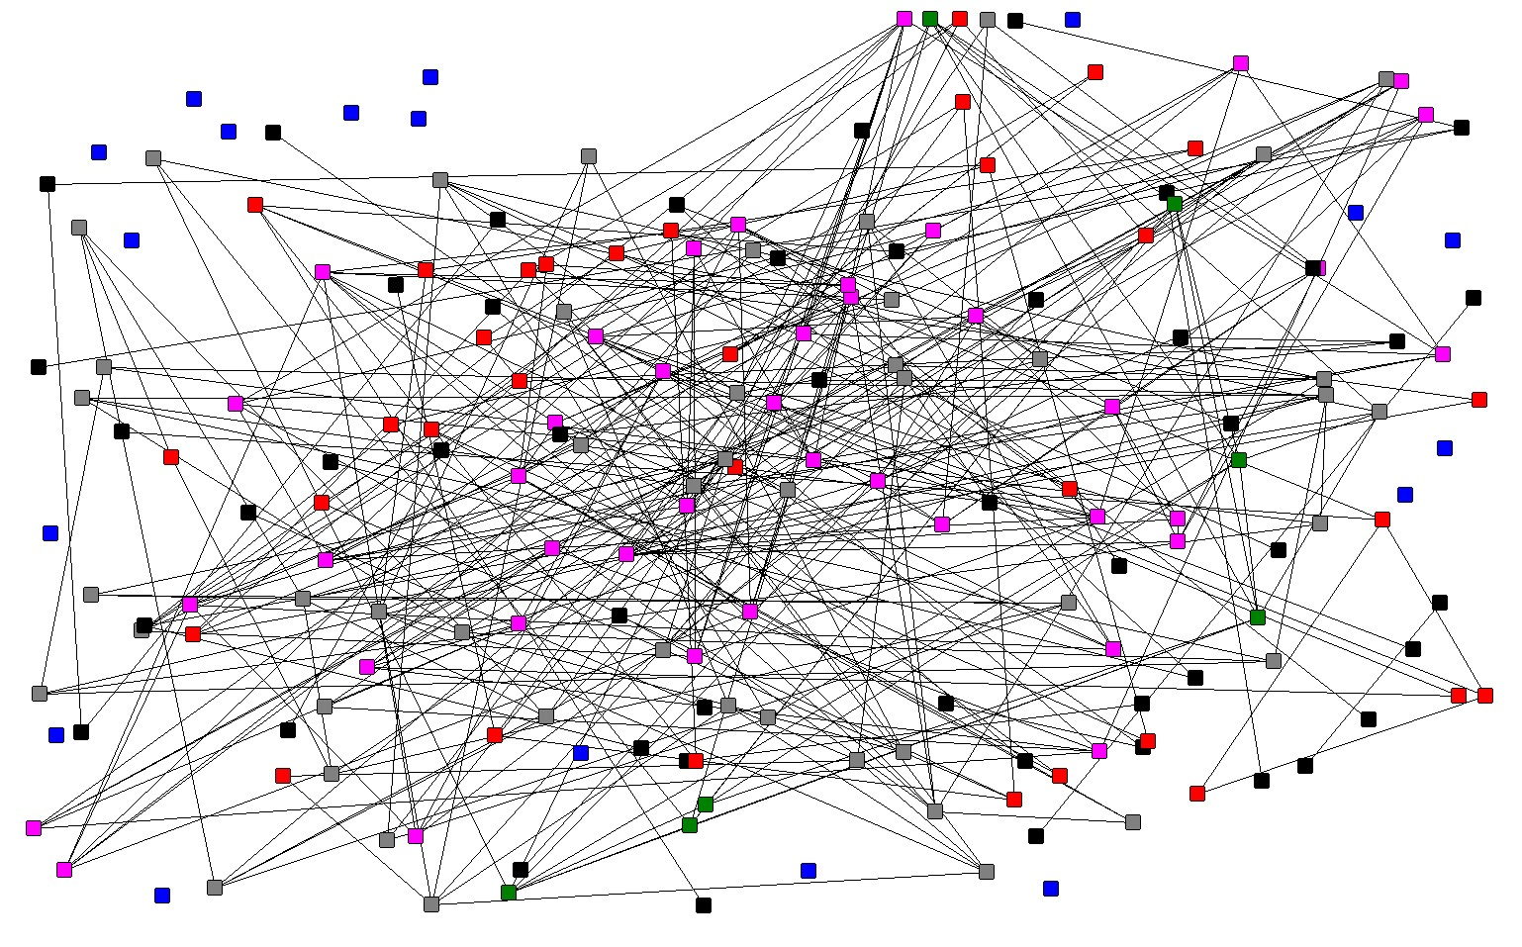
Technology Transfer
The German network of transfer offices
J. Kratzer, H. Haase, A. Lautenschläger (2010) 'Benchmarking deutscher Transferstellen: Transferpotential, Transferkapazität, Transferaktivitäten im deutschlandweiten Vergleich, Berlin u.a..
Prof. Dr. Kratzer, Lehrstuhl für Entrepreneurship und Innovationsmanagement

Slide 22
Alliances and Cooperations
Prof. Dr. Kratzer, Lehrstuhl für Entrepreneurship und Innovationsmanagement

Slide 23
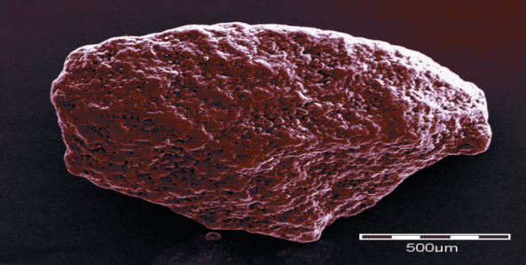
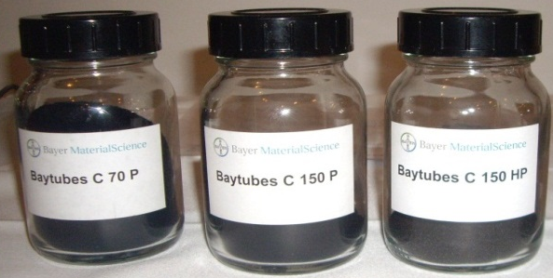

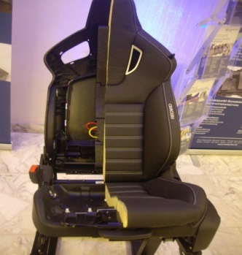
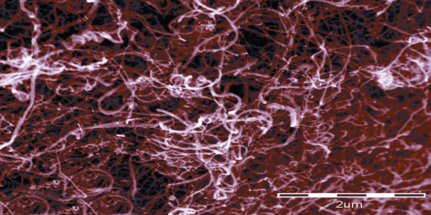
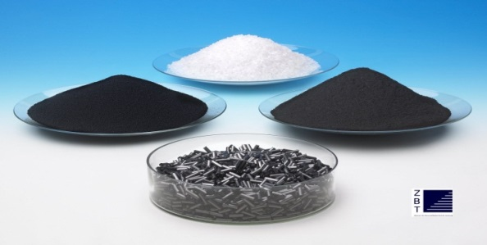
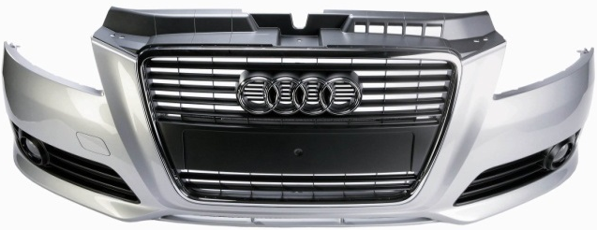
Interorganizational Innovation Networks
Creating a National Lead Market in Nanotechnologies
Research setting: National R&D network “Inno.CNT” (nanotechnologies)
Description: 90 companies, 250 individuals, 25 project groups, 50€Million BMBF funding, duration 2008-2014
Research project: Case study analysing network structure and processes with focus on network value creation
1
2
3
Carbon Nanotubes (close-up)
Nanotubes ready for use
Sample product applications
Prof. Dr. Kratzer, Lehrstuhl für Entrepreneurship und Innovationsmanagement

Slide 24
Sample Variables
Most Beneficial Combination
Most Beneficial Combination
Most Beneficial Combination
Weak Ties (Structural Holes, Bridging Ties)
Strong Ties
Weak Ties (Structural Holes, Bridging Ties)
Strong Ties
Weak Ties (Structural Holes, Bridging Ties)
Strong Ties
Contact Frequency
Trust
+
+
Reliability
Low tie strength
High tie strength
Low tie strength
High tie strength
Low tie strength
High tie strength
I. Michelfelder, J. Kratzer (2013) ‘Why and How Combining Strong and Weak Ties within a Single Interorganizational R&D Collaboration Outperforms Other Collaboration Structures’, Journal of Product Innovation Management, 30, pp. 1159-1177.
Prof. Dr. Kratzer, Lehrstuhl für Entrepreneurship und Innovationsmanagement

Slide 25
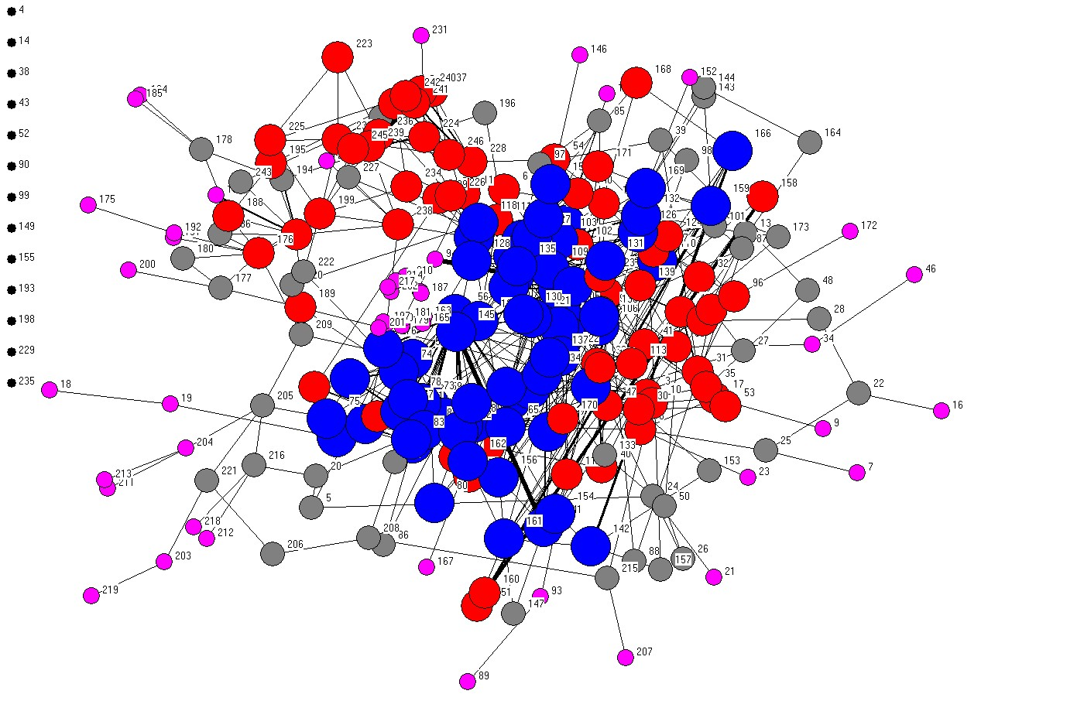
Interlocking directorates
K. van Veen, J. Kratzer, (2011) ‘National and international interlocking directorates within Europe: Corporate networks within and between 15 European countries’, Economy and Society, 40, pp. 1-25.
Prof. Dr. Kratzer, Lehrstuhl für Entrepreneurship und Innovationsmanagement

Slide 26
Projects/Teams/Leadership
Prof. Dr. Kratzer, Lehrstuhl für Entrepreneurship und Innovationsmanagement

Slide 27
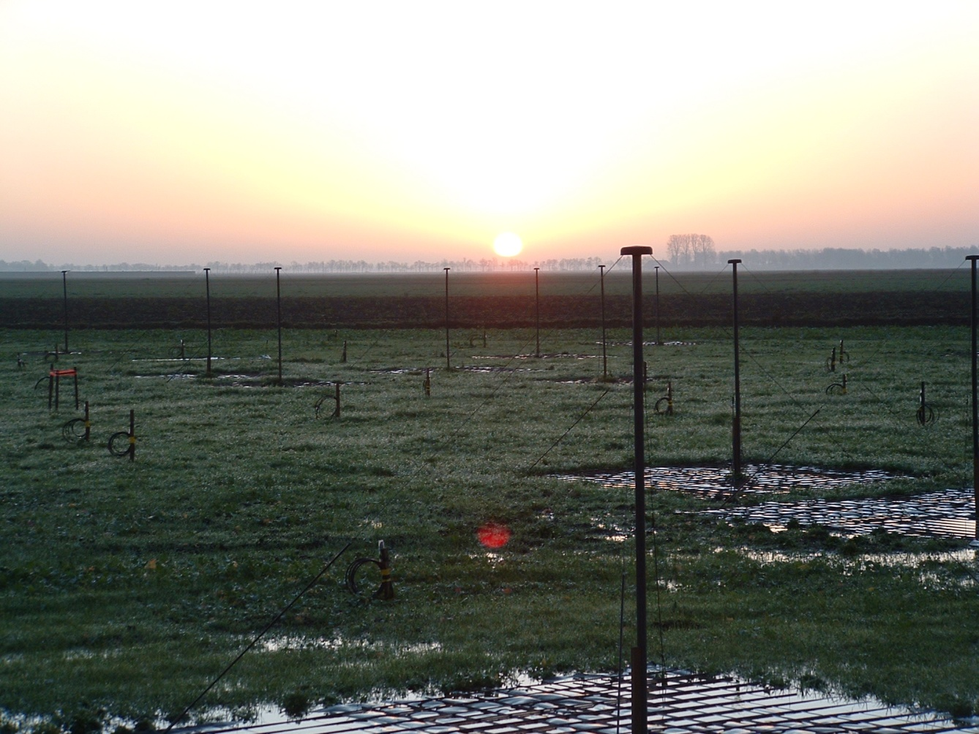
LOFAR (Low Frequency Array)
Prof. Dr. Kratzer, Lehrstuhl für Entrepreneurship und Innovationsmanagement

Slide 28
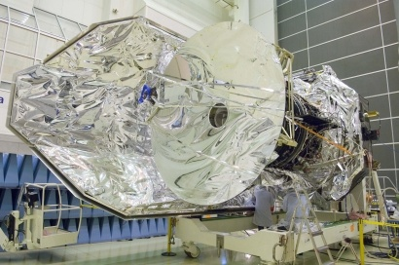
Herschel Space Observatory
Prof. Dr. Kratzer, Lehrstuhl für Entrepreneurship und Innovationsmanagement

Slide 29
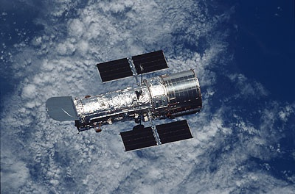
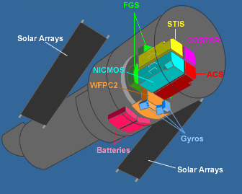
Hubble Space Telescope
Prof. Dr. Kratzer, Lehrstuhl für Entrepreneurship und Innovationsmanagement

Slide 30
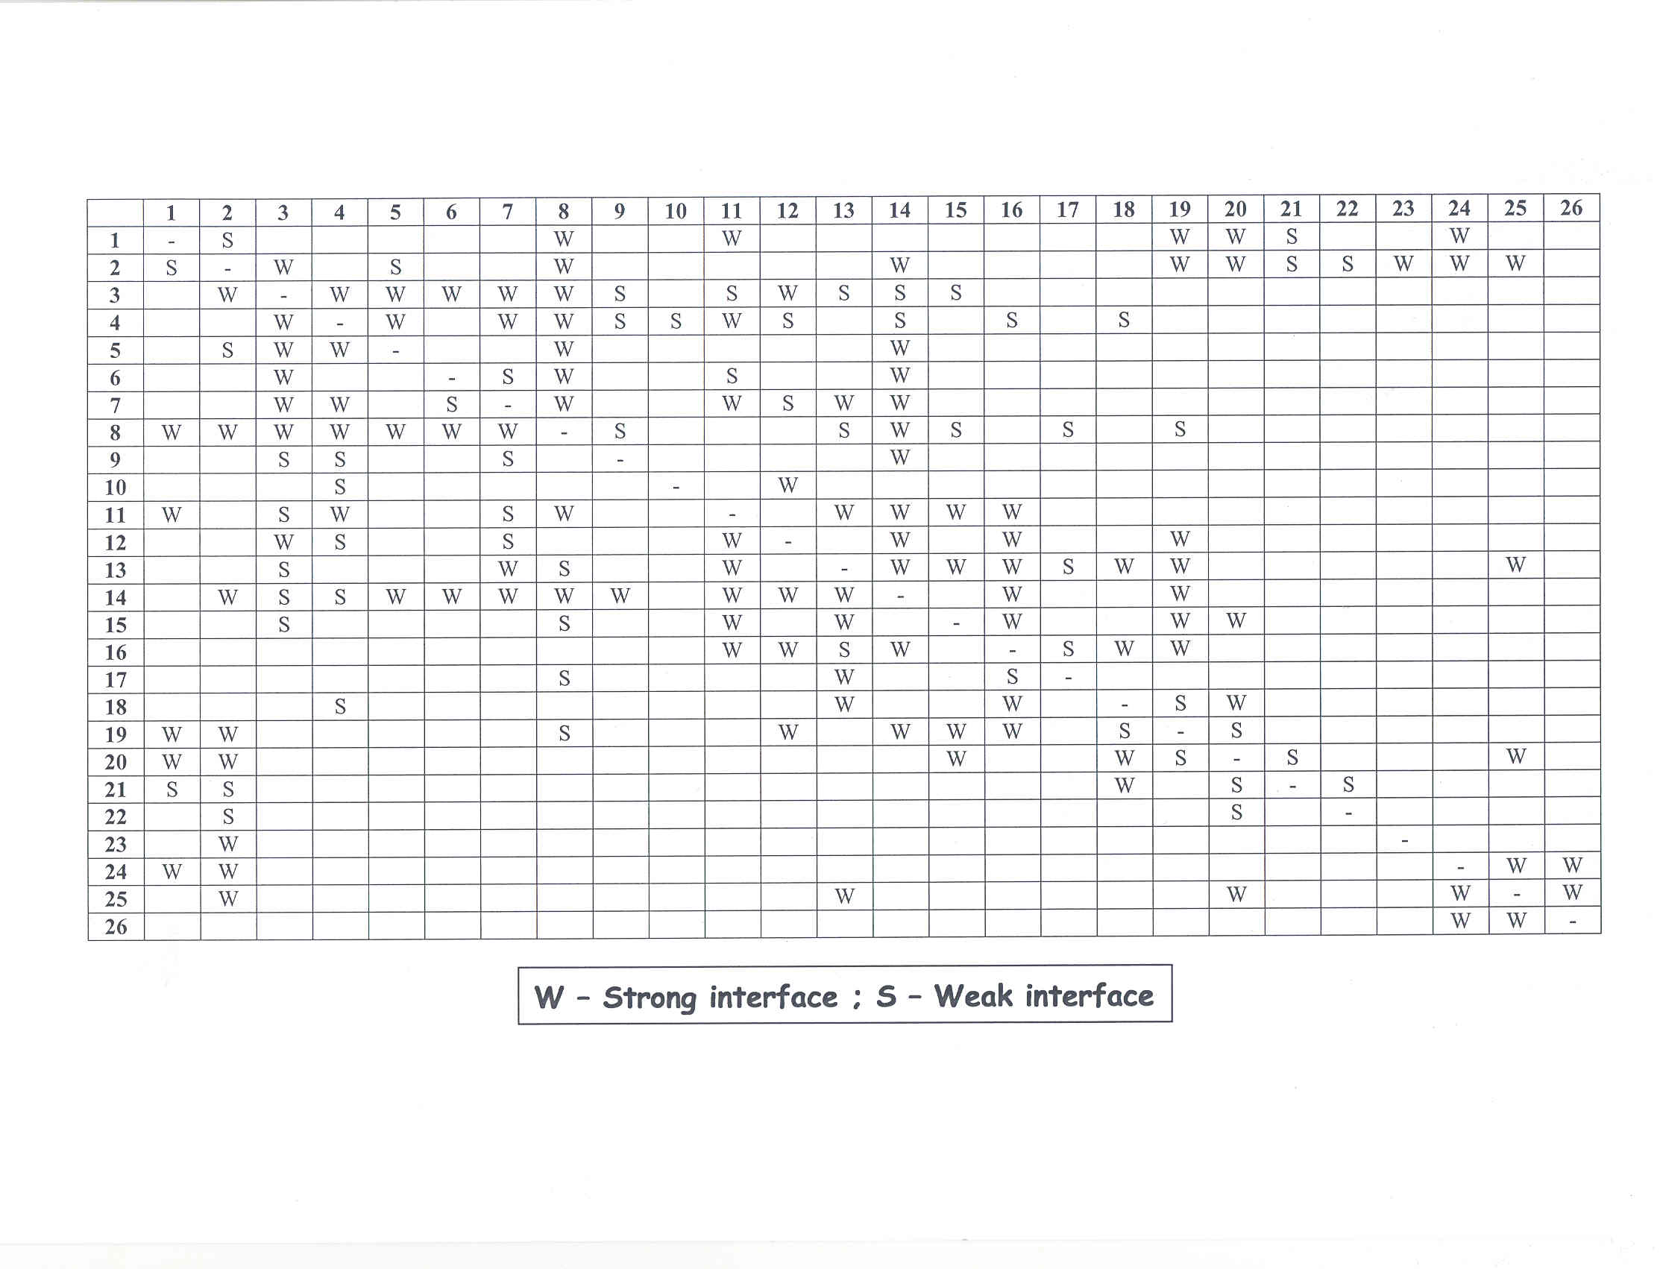
S
W
Prof. Dr. Kratzer, Lehrstuhl für Entrepreneurship und Innovationsmanagement

Slide 31
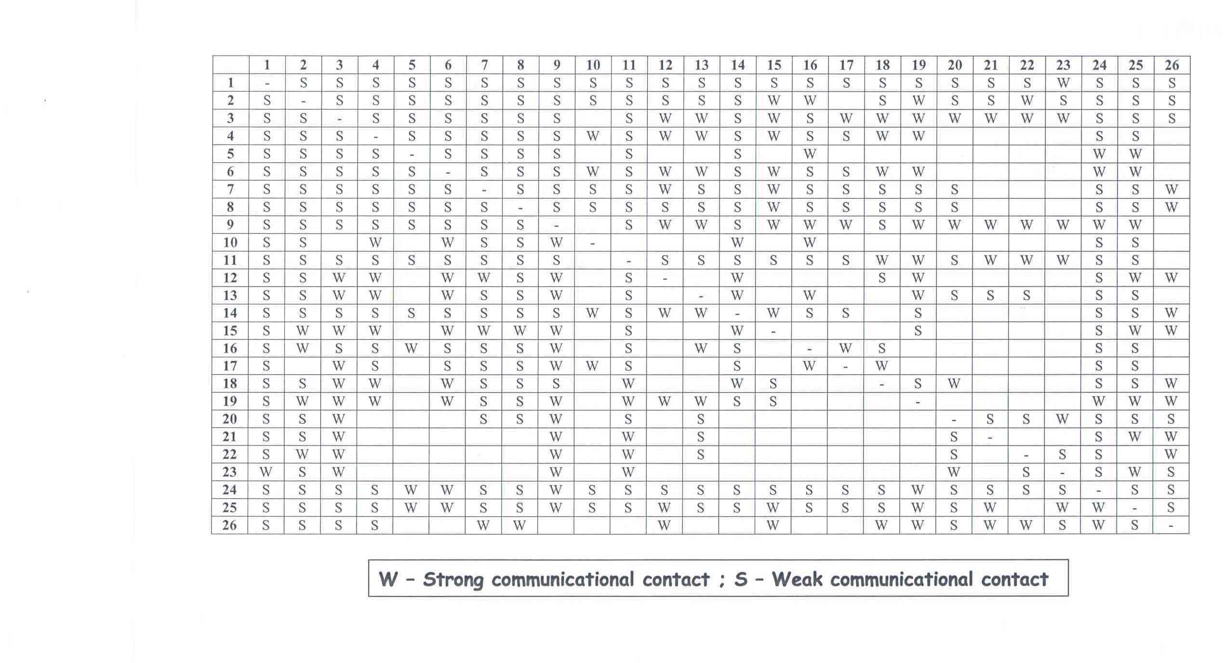
S
W
Prof. Dr. Kratzer, Lehrstuhl für Entrepreneurship und Innovationsmanagement

Slide 32
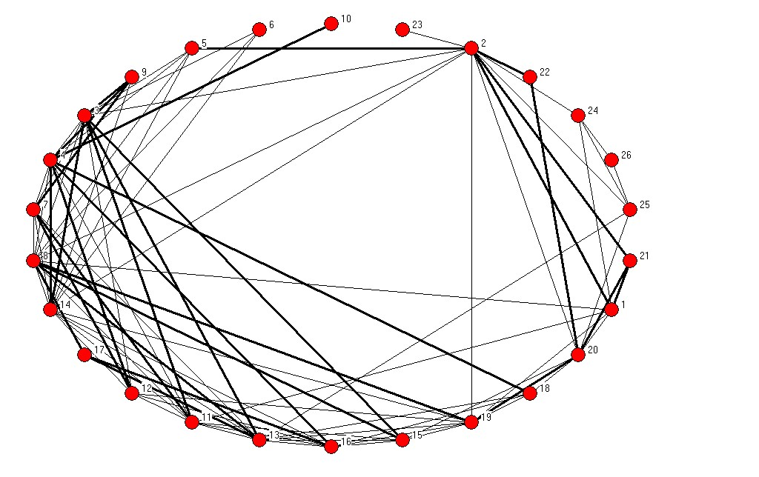
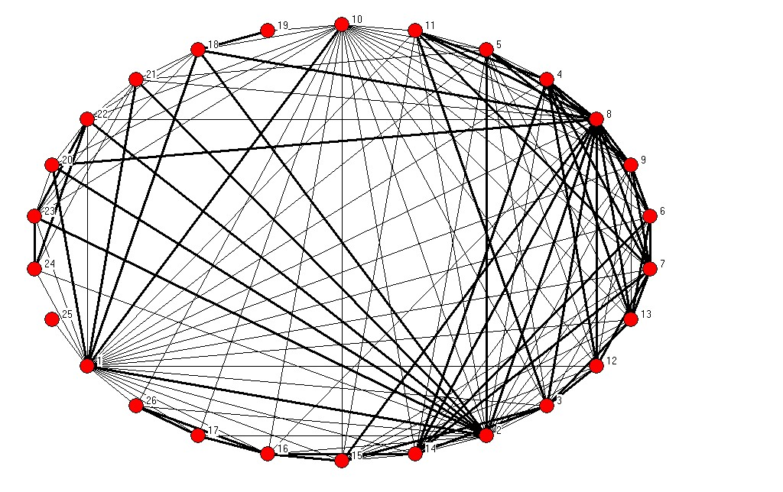
Design phase
Integration phase
Design Structure Matrix
Prof. Dr. Kratzer, Lehrstuhl für Entrepreneurship und Innovationsmanagement

Slide 33
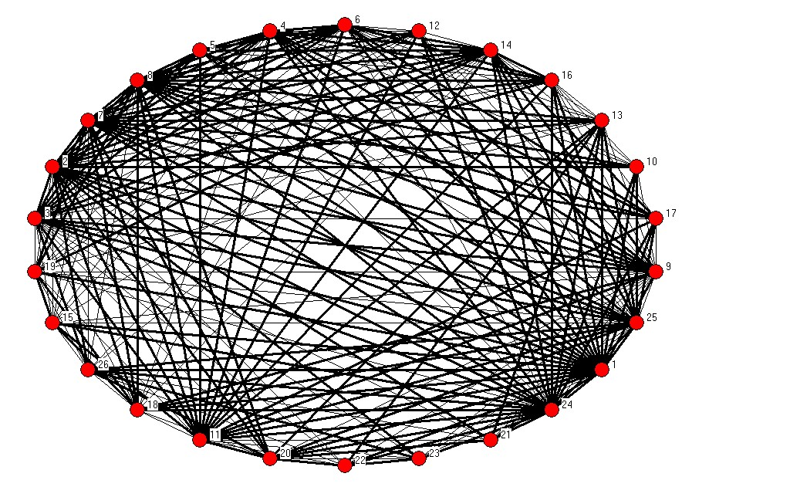
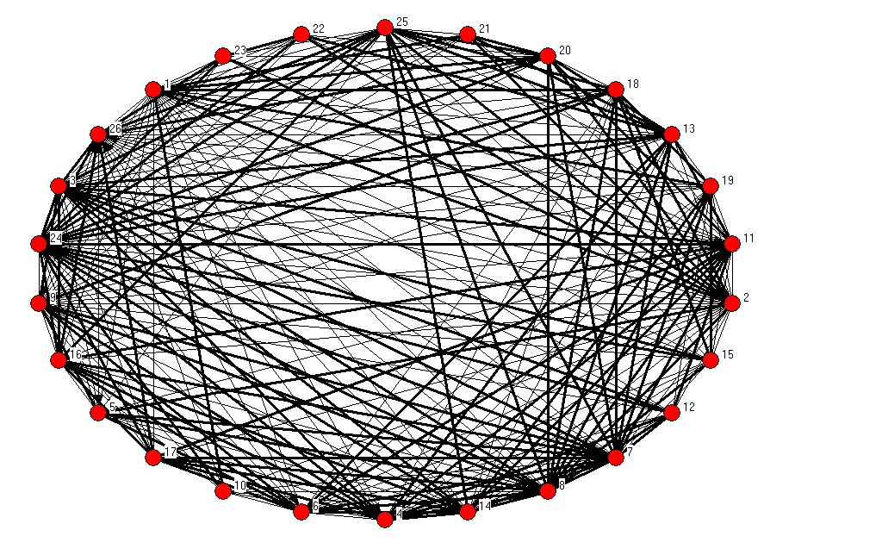
Design phase
Integration phase
Informal Communication Matrix
Prof. Dr. Kratzer, Lehrstuhl für Entrepreneurship und Innovationsmanagement

Slide 34
Collaboration A
Design structure matrix – design phase
.38***
Design structure matrix – integration phase
.27***
.31***
Informal communication matrix – design phase
.87***
Informal communication matrix – integration phase
ª .* p < .10, ** p < .05, ***p< .01
Collaboration B
Design structure matrix – design phase
.48***
Design structure matrix – integration phase
.25***
.39***
Informal communication matrix – design phase
.84***
Informal communication matrix – integration phase
ª.* p < .10, ** p < .05, ***p< .01
Prof. Dr. Kratzer, Lehrstuhl für Entrepreneurship und Innovationsmanagement

Slide 35
‘The creativity that is required of design teams is couched in the communication structure of the team.’
Csikszentmihalyi, P., Sawyer, K., 1995, Shifting the focus from individual to organizational creativity, In: Ford, C.M. and Goia, D.A. (eds.) Creative Action in Organizations, Thousand Oaks: Sage, 167-173
Prof. Dr. Kratzer, Lehrstuhl für Entrepreneurship und Innovationsmanagement

Slide 36
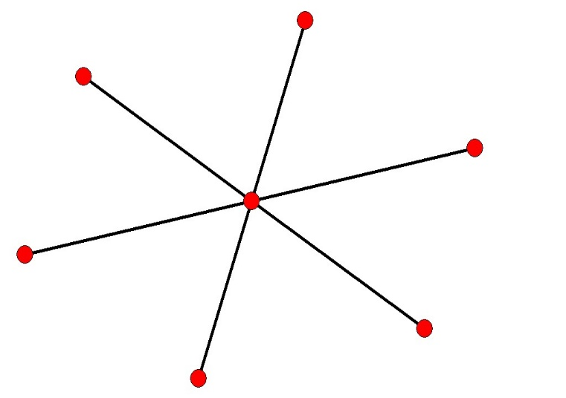
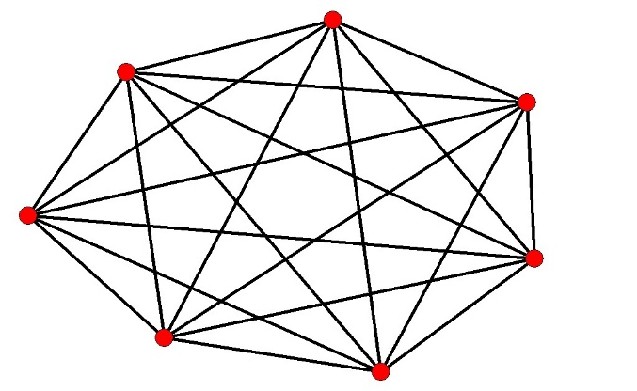
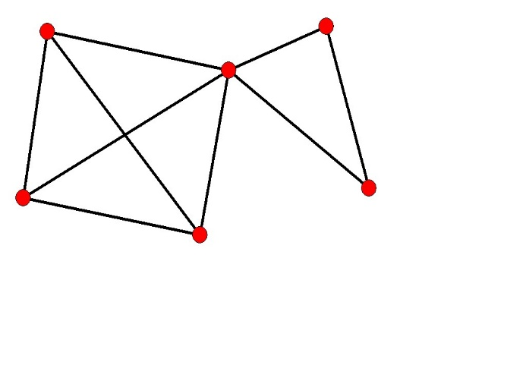
Centralization
Frequency
Segmentation
Prof. Dr. Kratzer, Lehrstuhl für Entrepreneurship und Innovationsmanagement

Slide 37
Model 3
Model 4
Intercept
5.43
***
(.18)
5.28
***
(.19)
Frequency of interaction
-1.13
***
(.32)
-1.08
***
(.33)
Frequency of interaction²
-5.10
***
(1.51)
-4.44
***
(1.53)
Subgroups
-.04
(.05)
-.04
(.05)
Centralization
-.16
*
(.09)
-.15
*
(.08)
Level of disagreement
-.24
**
(.12)
Level of disagreement²
.22
(.14)
Team tenure
-.31
**
(.13)
-.29
**
(.13)
Adjusted R²
.51
.54
*p < .10, **p < .05, ***p < .01, 44 Design Teams/243 Team Members
Prof. Dr. Kratzer, Lehrstuhl für Entrepreneurship und Innovationsmanagement

Slide 38
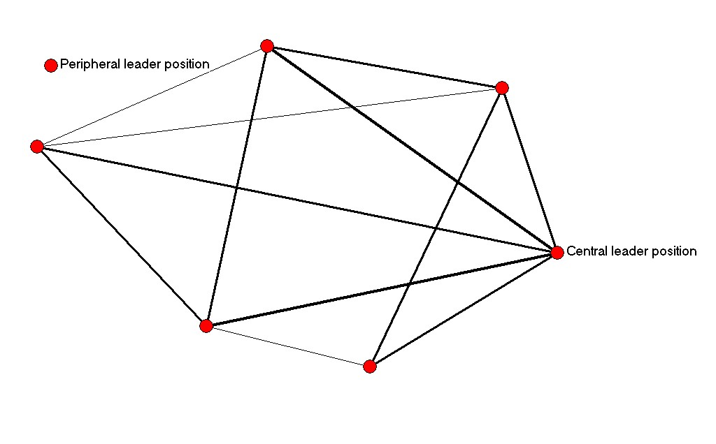
The balance between central and peripheral leader positions
Prof. Dr. Kratzer, Lehrstuhl für Entrepreneurship und Innovationsmanagement

Slide 39
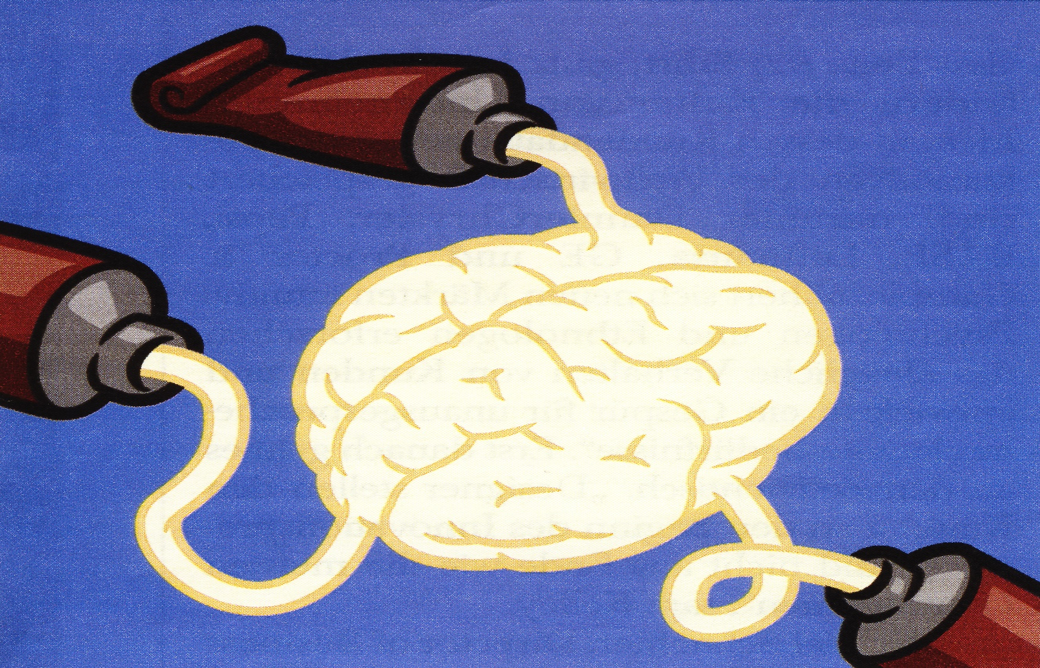
Different network flows
Prof. Dr. Kratzer, Lehrstuhl für Entrepreneurship und Innovationsmanagement

Slide 40
Network property | Relationship between leader centrality and creativity | Managerial implications
Work-flow |  | The involvement in work-related exchanges should be moderate to a level where leaders can assess the processes, evaluate outcomes, and intervene when necessary.
Problem-solving |  | The involvement in the problem-solving process of the team members should strictly be kept to a minimum.
Awareness |  | The involvement in the awareness network should be moderate to a level where leaders can monitor information flows and navigate them when required.
Information: Boundary spanning capacity |  | Leaders should invest in external networks to provide their own team with all access to knowledge and information possible to fulfill the tasks.
Creativity
Centrality
Creativity
Centrality
Creativity
Centrality
Creativity
Centrality
Prof. Dr. Kratzer, Lehrstuhl für Entrepreneurship und Innovationsmanagement

Slide 41
R.Th.A.J. Leenders, J.M.L. van Engelen, J. Kratzer, (2003) ‘Virtuality, Communication, and New Product Team Creativity: A Social Network Perspective’, Journal of Engineering and Technology Management, 20, pp. 69-92.
J.Kratzer, R.Th.A.J. Leenders, J.M.L. van Engelen, (2004) ‘Stimulating the potential: creativity and performance in innovation teams’, Creativity and Innovation Management, 13, pp. 63-70.
J. Kratzer, H.G. Gemuenden, CH. Lettl (2008) ‘Revealing dynamics and consequences of fit and misfit between formal and informal networks in multi-institutional product development collaborations', Research Policy, pp. 1356-1370.
J. Kratzer, R.Th.A.J. Leenders, J.M.L. van Engelen, (2008) ‘The social structure of leadership and creativity in engineering design teams’, Journal of Engineering and Technology Management,pp. 269-286.
J. Kratzer, R.Th.A.J. Leenders, J.M.L. van Engelen (2010) ‘Structural embeddedness and creativity: A case study among units of a multinational R&D program’, International Journal of Project Management, 28, pp. 93-95.
J. Kratzer, H.G. Gemuenden, CH. Lettl, (2011) 'The organizational design of large R&D collaborations and its effect on time and budget efficiency: The contrast between blueprint and reality`, IEEE Transactions on Engineering Management, 2, pp. 295-306.
Prof. Dr. Kratzer, Lehrstuhl für Entrepreneurship und Innovationsmanagement

